Slide 1
OIS 6660
Adam Tidwell
12/4/14

Slide 2

Agenda
Quiz
Discussion
Procurement Management
Stakeholder Management
Closing
Group project
Create Procurement Management Plan
Create Stakeholder Register
Create Closing documents

Slide 3

Quiz 8
On Canvas
25 minutes
Closed book/internet

Slide 4
Discussion
PMBOK
Chapter 12: Project Procurement Management
Chapter 13: Project Stakeholder Management

Slide 5
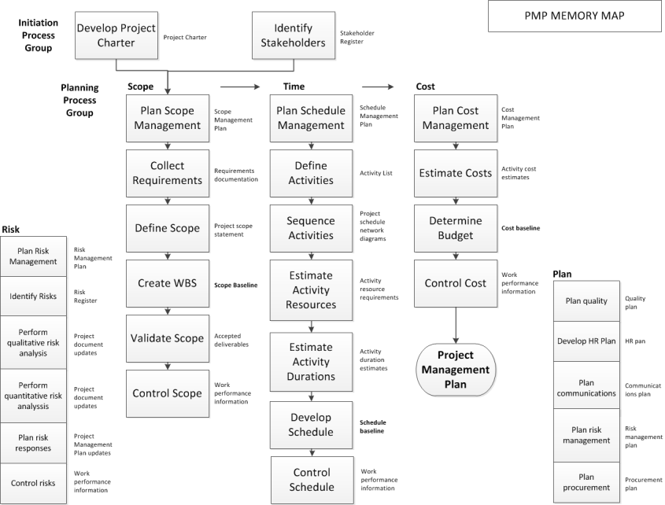
Notes:
Know the inputs and outputs for the quiz

Slide 6
Project Procurement Management

Slide 7
Types of Contracts
Fixed Price Contracts
Firm Fixed Price (FFP)
Fixed Price Incentive Fee (FPIF)
Fixed Price with Economic Adjustment (FP-EPA)
Good for clearly defined scope
Easier to manage
Seller may not complete if not profitable
Cost Reimbursable
Cost Plus Fixed Fee (CPFF)
Cost Plus Incentive Fee (CPIF)
Cost Plus Award Fee (CPAF)
Uncertainties exist in scope
Flexible
More work to audit
Time and Material
Hybrid
Short term
Most oversight
Notes:
Very important

Slide 8
Procurement Management Plan
How a project team will acquire goods and services from outside the performing organization
Type of contract
Risks or constraints
Scheduling/timeline
Things to be aware of for each vendor

Slide 9
Project Stakeholder Management
Notes:
Know inputs and outputs

Slide 10
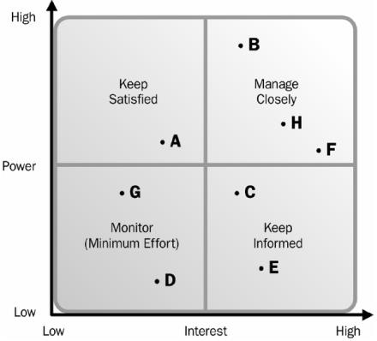
Stakeholder Classification
Steps
Identify
Analyze impact
Anticipate reaction
Classification models
Power/interest
Power/influence
Influence/impact
Salience model
Engagement levels
Unaware
Resistant
Neutral
Supportive
Leading
Notes:
Very important

Slide 11
Stakeholder Register
Identification information
Assessment information- requirements, expectations, influence
Stakeholder classification- Power/Influence, etc.

Slide 12
Closing
Summary of results
Hand off activities
Lessons learned
Update documents
Formal approval to close project

Slide 13
Group Project
Create Procurement Management Plan
Create Stakeholder Management Plan
Create closing document
Create lessons learned

Slide 14
Procurement Management Plan
Create a Procurement Management Plan with at least 2 vendors
For each vendor, include:
Type of contract
Risks or constraints
Scheduling/timeline
Things to be aware of for each vendor

Slide 15
Stakeholder Management Plan
Create a Stakeholder Management Plan
Include at least 5 stakeholders
Include
Identification information- name or position
Assessment information- requirements, expectations, influence, etc.
Stakeholder classification- using Power/Influence grid

Slide 16
Closing Documents
Create a closing document for your project formally completing the project work.
Include:
Summary of results
Hand off activities
Lessons learned (see below)
Formal approval to close project
As a project team, create a lessons learned document for your project that summarizes what you learned in class by doing this group project.

Slide 17
PMP/CAPM Test Prep

Slide 18
Test Prep
Test best practices
Practice questions

